Slide 1
Lesson 14 – Homework review

Slide 2
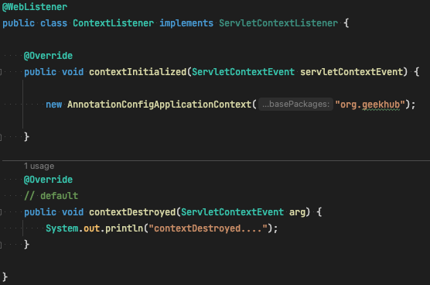
ApplicationContext vs ServletContext

Slide 3
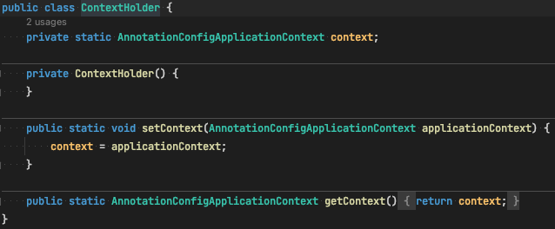
ApplicationContext vs ServletContext

Slide 4
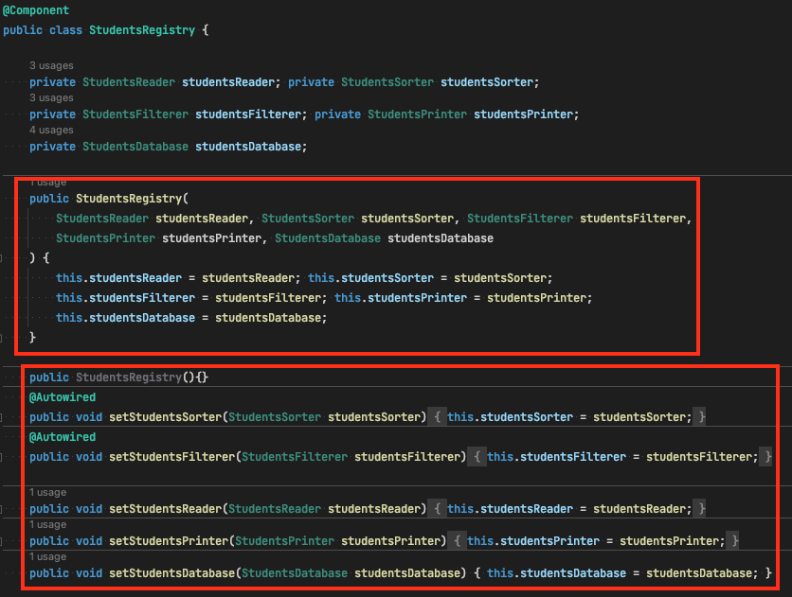
Prefer only one DI type (What is recommended?)

Slide 5
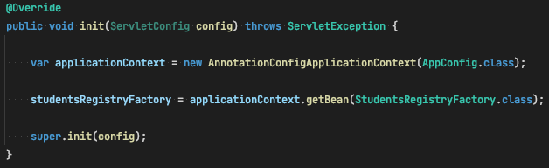
Spring Context and Servlet init

Slide 6
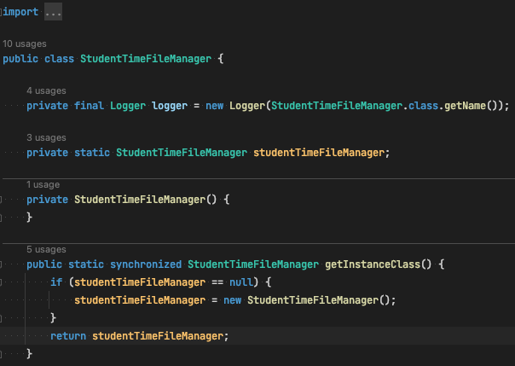
What wrong with this code in context of Spring?

Slide 7
Thanks!
Any Questions?
Or find us in Slack:
@Yaroslav Brahinets
@Vasya Rudas

